Slide 1
NavMeshes & PathPlanning
GAM 376

Slide 2
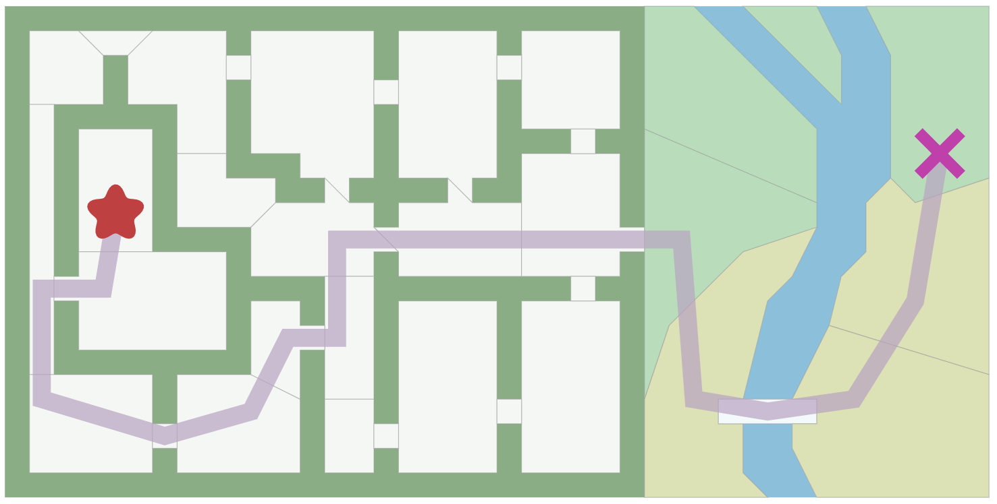
Path Planning
How does a AI bot navigate the world?
Lets start off with a simpler problem
Navigating a floor of a building?

Slide 3
Path Planning
We need a graph in order to plan our path!
Then we will use our pathfinding algorithm to create the most optimal path
How do we create this graph?
What did we use last week?
Using POVs
Lets assume there is no nav mesh, just the POVs.

Slide 4
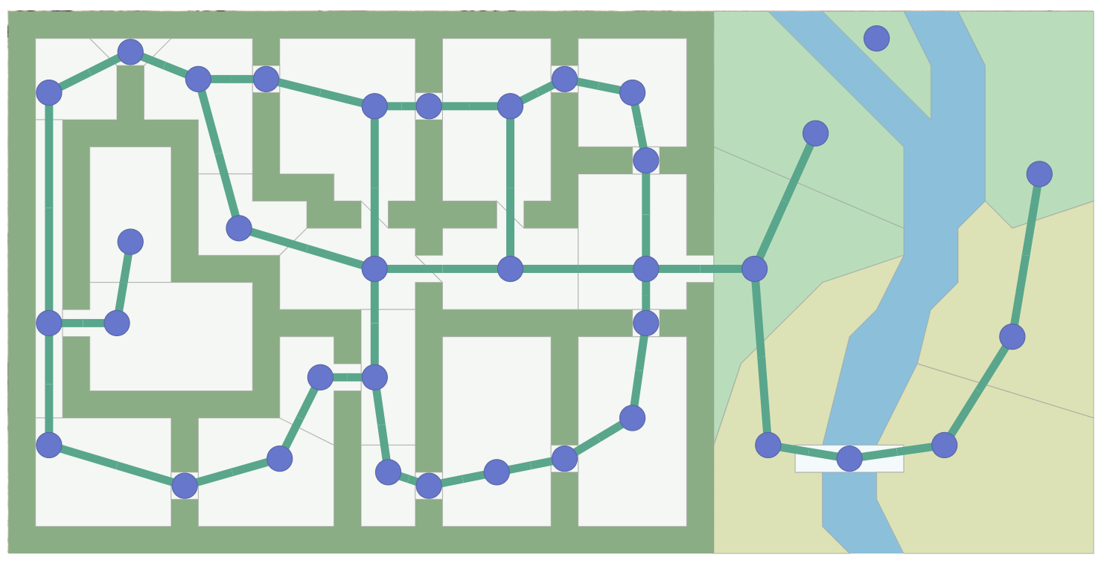
Points of Visibility
Create a graph such that each node is visible from at least one other
For traverse from 1 point to another. A simple lerping function would suffice.

Slide 5
Points of Visibility
Pros
Easy to create!
Easy to use and understand!
Cons
POV by itself, is very limiting.
Works well in 2d or completely flat 3D terrain surfaces
Time consuming to create,
Incapable to handle complex 3D environments.

Slide 6
Navigation Meshes
The industry standard
In some form or another
Pathfinding demo from last week was using POVs on top of a NavMesh.
Which is common.

Slide 7
NavMesh
An automated technique
Represent the world as connected convex spaces (polygons)
Uses the surface details of a static meshes in a scene
An agent can go anywhere in the convex space
without worrying about obstacles
Adjacent polygons are connected to each other
If I can navigate to the right mesh space
then steering behaviors will do the rest

Slide 8
2 types of NavMeshes
Triangle based
All polygons must be triangles
When done correctly, will not hug walls too tightly
N-Sided-Poly-based
Can have any number of sides, but must remain convex
Can usually represent a search space more simply than triangle based (smaller memory footprint)
Can lead to paths that hug walls too tightly

Slide 9
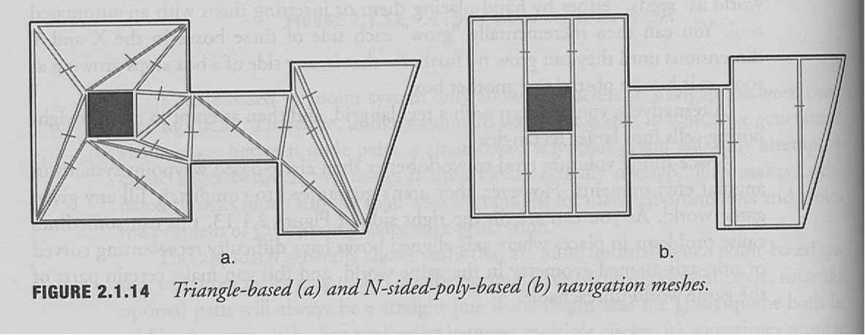
2 types of NavMeshes

Slide 10
NavMesh Representation
A polygon is a set of edges
Each edge connects to (at most) one other polygon
Each edge is a vector in world space
has (x,y,z) coordinates
For search purposes
polygons are graph-nodes
shared edges are graph-edges

Slide 11
Building a NavMesh
Based on the bounding geometry of the level
You want the largest polygon
that coincides with bounding vertices at all points
In general, you have only one shared edge
with any other polygon
otherwise break up

Slide 12
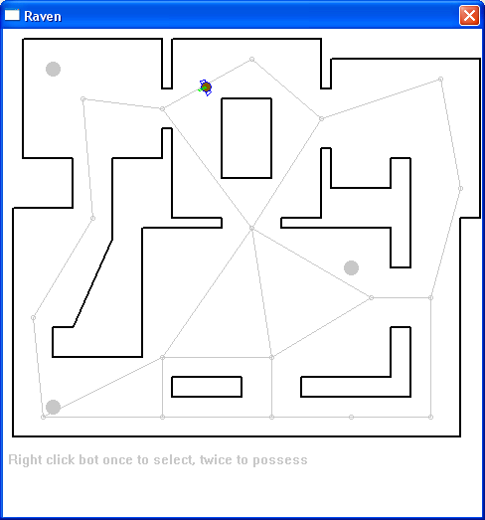
X

Slide 13
NavMesh Pathfinding
To find a path from A to B
find the polygon enclosing A
find the polygon enclosing B
search from A to B
Results
the edges that must be traversed between spaces
usually aim for the midpoint of each edge

Slide 14
Spatial Partitioning
Quantization: how to find the polygon for a given point?
spatial partitioning
as in flocking
This is the answer to questions like
“what objects are near point (x,y,z)?”
Don’t want to have to search all objects

Slide 15
Spatial Partitioning
Divide the world into partitions
usually based on the presence of objects
few objects = few partitions
each partition has some small number of objects
too many objects in a partition
split the space
Techniques
binary space partitioning (BSP)
very popular in games
quad-trees
oct-trees
others

Slide 16
Path to Item Type
What if we don’t have a target node?
Find the closest health pack
Don’t want to run a separate search for each health pack location
Use Dijkstra’s or A* algorithm instead
searches all paths of cost k before looking at more expensive ones
will find the closest matching destination

Slide 17
Smoothing
Paths look unnatural
especially beginning and end
agents don’t move smoothly through space
because they are following the graph edges
Solution
delete edges if the intervening node can be reached directly

Slide 18
Rough Smoothing
Pair-wise edge deletion
Move along the path
If the next node can be reached directly
delete the extra edge
go directly to next
Keep checking
O(n)

Slide 19
Precise Smoothing
Greedy edge deletion
Move along the path
Consolidate as many edges as possible
from current node
Then go to next
O(n²)

Slide 20
Planning Efficiency
Planning is slow
We may need to have many agents planning their motion
Cannot afford to do lots of calls to the path planner

Slide 21
Pre-computing
Trade off space vs time
Compute paths in advance
store in a lookup table
For each node
store the most efficient path to every other node
Requires n² space
but constant time lookup
some paths may be (much) more frequently requested
Not compatible with dynamic environments

Slide 22
Time-sliced Planning
Basic idea
Path planning must not slow down the game
no matter how many agents there are
Obviously
we cannot assume that path planning can be complete
in a single execute cycle
Must decouple path planning as a separate process
Benefit
we can treat this as a separate resource
fix the CPU budget for it

Slide 23
Basic idea
Separate path planner object
Agents make planning requests
asynchronous
Agents notified when a path has been computed
Agents must have something to do while planning is happening

Slide 24
Search cycle
Inner loop
grab node
add to path
check for target
expand search frontier
If we encapsulate data separately
(start, target, path, search queue)
then we can work on several searches at once
Each execute cycle
the planner processes one node
not arbitrarily costly

Slide 25
Waiting for Planning
Agent must not be idle during planning
looks really stupid
Agent can
wander
not efficient, but easy
seek toward destination
looks purposeful
Caution
agent may have moved from path start point
must use smoothing to reshape path to current location

Slide 26
Side Note: Threading
You can take it one step further by doing the pathfinding calculation on a separate thread!
Much more advance technique
Basic Idea
Take a snapshot of the world as it stands
Send that data and the player’s data to another thread
They start calculating a path for the player
While the player waits for their path they can roughly head towards their target.
Then before the player gets to far the thread calculation should be complete and can pass the path back to the player

Slide 27
Hierarchical Pathfinding
How to get to the Statue of Liberty?
cab to the airport
plane to New York
then bus,
then water taxi
We don’t start by thinking about the one-way streets in the Loop

Slide 28
Hierarchical Pathfinding II
Multiple graphs at different resolutions
a navmesh for the level
a complete grid for each room
To traverse the level
we first plan at the higher level
result = a path of “room-sized” nodes
each edge enters / exits one polygon face
To get from face to face in the room itself
we plan again at the lower level
such plans are perfect for pre-computing

Slide 29
Problems
Anomalies in hierarchical paths
a rough graph may miss details that can shorten paths
esp. if generated automatically: narrow shortcuts
weights on the hierarchical graph have to "summarize" possible low-level paths
no way to do this and be right all the time
Agent capabilities
not all spaces can be traversed by agents equally
fat vs skinny
can jump vs can’t jump
turning radius
if you don’t want a different graph for each agent
must embed constraints in the graph somehow
must include constraints in graph search
harder to do hierarchically

Slide 30
Navigation Meshes in Development
Navigation is an often critical and under appreciated element of game development
Don’t notice when its working, but notice when its not.
Assassin's Creed
GTA 5
Just funny
Movement can quickly break immersion

Slide 31
NavMesh in 3D Games
How Navigation Meshes Work in 3D Games
Great youtube series!

Slide 32
Unity Demos
Now were going to go over the basics of navigation meshes in Unity.
Unity’s Components for Runtime Navmesh

